Slide 1
State of the
Rensselaer Union
Presentation to the Class of 1979
November 18, 2025
Jon Kessler, ‘79, ‘82G
Charlie Potts, Director of the Union

Slide 2
MAJOR TOPICS
Overall state of the building
Rathskeller games room renovations
Governance, both student & administrative
Clubs & student participation
Exterior projects
Future endeavors

Slide 3
State of the building
Last major overhaul was 1999-2000, Rick Hartt era
  Elevator, Mother’s moving to part of the games room, bowling alley shutdown
  Exterior balcony enclosures (3 out of 4), including pub on 15th Street side
  Reconfiguration of meeting rooms and offices
Smaller changes over the past 25 years, e.g. campus mail center
Summer 2024 initial Rathskeller updates
  Bookstore frontage
  Dining area, seating, and food vendors
Refresh of the student government suite
Chaplains’ offices (2nd floor NE corner) moved to Academy Hall, with space now repurposed, including fraternity & sorority offices
Lavendar Lounge updates recently completed

Slide 4
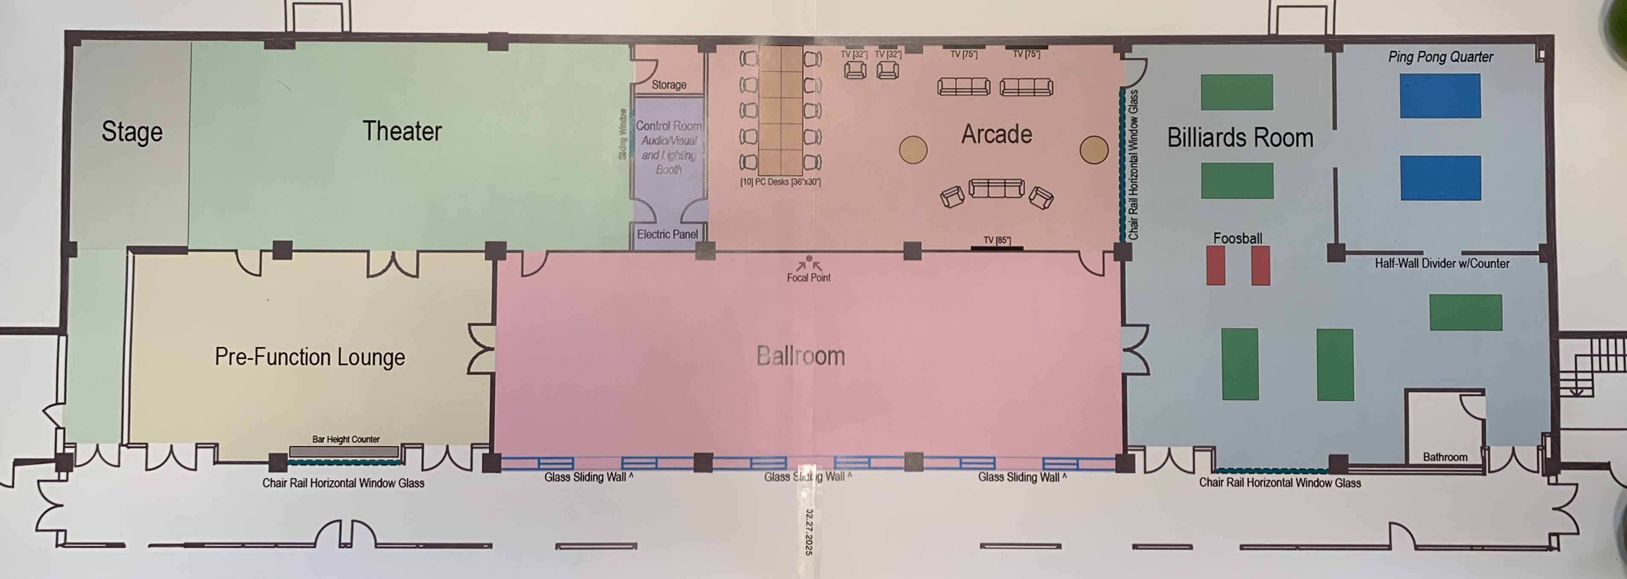
Rathskeller games room reconstruction

Slide 5
Rathskeller games room reconstruction
Former “Mother’s” space moved to west side, in former bowling alley area
  Multipurpose theater and music performance space with stage
  Also useful for group presentations
Pre-Function Lounge in front of the theater, multipurpose
Ballroom is an extension of the regular Rath dining area
  But it can be enclosed for special events
Arcade area for video gamers
Billiards and ping pong tables have separate area
This was all done from May to August 2025 to minimize disruption to students

Slide 6
Governance
New RPI administration with President Marty Schmidt, Class of 1981 (and former Bray Hall resident!) is a breath of fresh air
Prior antagonism and oppressive SAJ oversight is gone, along with most or all of the previous RPI administration (with new Trustees also)
Union is still very much a part of the Institute, but much freedom has been restored
Charlie reports that RPI respect for student government has increased
Reporting structure for the Director of the Union is now
Director > Vice Provost, Student Life > Provost > President Schmidt
  Big change from previous toxic arrangement with Dean of Students as an obstructive intermediary

Slide 7
Clubs and student participation
The Union continues to sponsor and fund many different clubs and activities
  Student government, of course, with Senate and E-Board, with class reps
  Loads of special interest clubs, from Ski Club to RPI Ambulance to ethnic groups and many more
  The RPI Players are currently putting on shows at Russell Sage College’s theater, as the RPI Playhouse on 15th Street was damaged by a flood and is unusable. Future under discussion.
  50 club sports (a surprise to me) – not intramurals which are campus-based, but these are non-NCAA sports teams that travel and compete against other colleges
  A sore spot with me: Publications are basically dead – no Transit yearbook, Unicorn, Engineer, Gorgon, with the Poly on life support
Prior (circa 2020-01) student participation was severely impacted by Covid, but has gradually come back. However…
  The ARCH program (which was recently scaled back) has been a continuing issue, as its semester-long interruption for juniors has had the unintended effect of affecting the progression of club leadership roles

Slide 8
Exterior projects
Experiment with food service during good weather (which leaves out 6 months in Troy ☹) outside on the south patio facing the Armory
New Ropes Course on Sunset Terrace near Bryckwyck (at the former site of W2SZ)
New outdoor Sports Court in the area near Nugent and Warren Halls, and the back of the Bouton Road softball field

Slide 9
Future endeavors
The 1999-2000 building renovations were funded by a 25-year bond, with interest paid from a special assessment added to the student activity fee
Even though that bond was recently retired, the E-Board has elected to continue funding the budget line item previously used for the bond, despite the temptation to eliminate the expense and lower the activity fee. Why? (see next item)
A grand plan is taking shape to expand the building structure which will require considerable expenditures. Just like our predecessors in 1957 who self-taxed for construction of the present Union, and the same in 1999 for major renovations, the current students are looking to the future for projects probably requiring millions of dollars.
One short-term less expensive project is under discussion to finally enclose the fourth exterior balcony on the south side. This will coordinate with the large meeting room adjacent to it
AND… That brings us to alumni gifts given directly to the Union, including (hopefully) a nice sum collected for our 50th Reunion in 2029…

